Slide 1

Learning Objective
I will be able to apply the combination rule[${{}_{ }^{n}C}_{r}$] for counting
Success Criteria
At the end of the lesson, I will be able to:
understand and be able to apply the combination rule [${{}_{ }^{n}C}_{r}$] for counting;
understand the difference between combinations and permutations;

Slide 2
Combinations – the idea is that order is NOT important
Concept Development
Situation: You have eight balls marked with the numbers 1 to 8. You are asked to pick three balls from the eight balls. If we have chosen the numbers 5, 7 and 8.
Permutations (with order)
The SIX possible arrangements are:
5 7 8
5 8 7
7 5 8
7 8 5
8 5 7
8 7 5
Combinations (without order)
The is only ONE possible way:
5, 7 ,8
(picking them all at the same time)
6
1

Slide 3
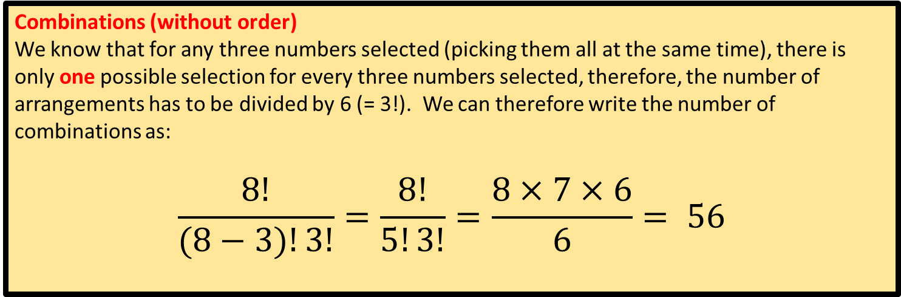

Concept Development
Situation: You have eight balls marked with the numbers 1 to 8. You are asked to pick three balls from the eight balls.
Permutations (with order)
The number of possible permutations is: (using ${}_{}^{n}{P_{r}}$)
$\frac{8!}{\left(8−3\right)!}= \frac{8!}{5!}=8×7×6$=336
Combinations (without order)
We know that for any three numbers selected (picking them all at the same time), there is only one possible selection for every three numbers selected, therefore, the number of arrangements has to be divided by 6 (= 3!). We can therefore write the number of combinations as:
$$\frac{8!}{(8−3)!3!}=\frac{8!}{5!3!}=\frac{8×7×6}{6}= 56$$

Slide 4
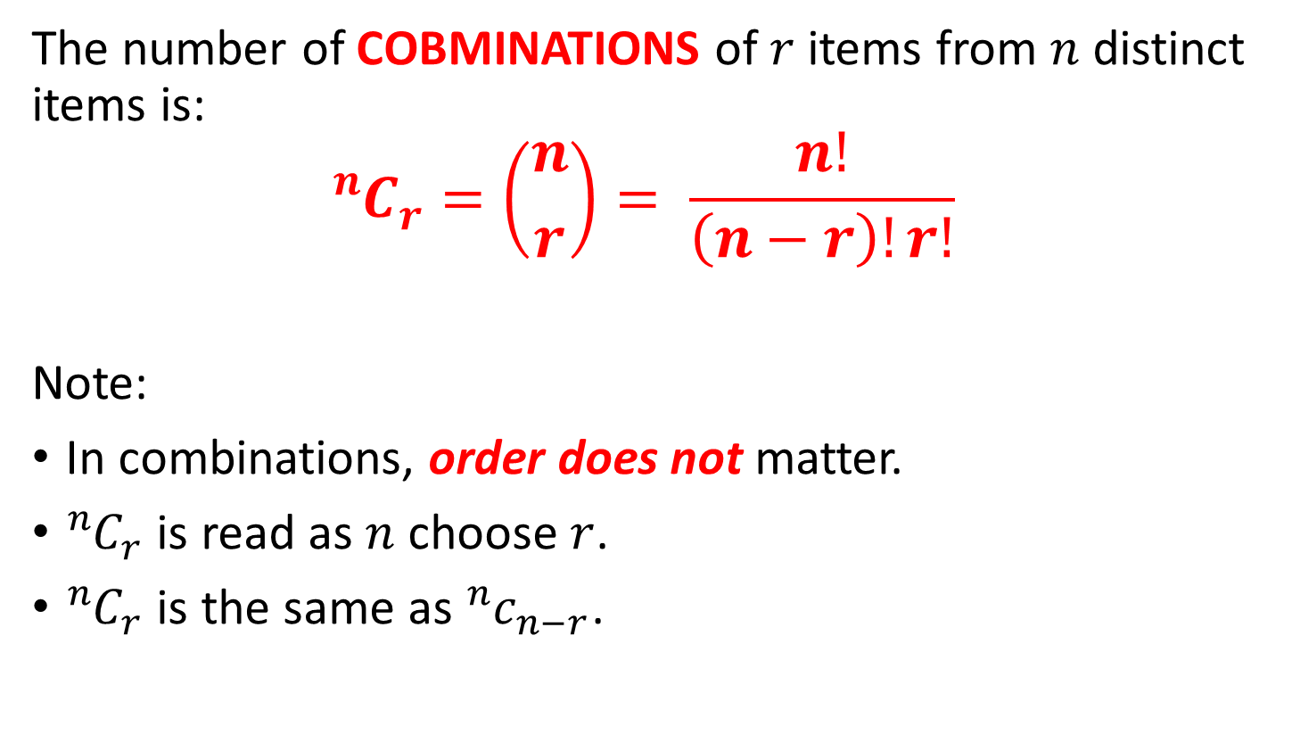
Combinations
Concept Development
The number of COBMINATIONS of $r$ items from $n$ distinct items is:
$${}_{ }^{n}{C_{r}=\left({n \atop r}\right)= \frac{n!}{\left(n−r\right)!r!}}$$
Note:
In combinations, order does not matter.
${{}_{ }^{n}C}_{r}$ is read as $n$ choose $r$.
${{}_{ }^{n}C}_{r}$ is the same as ${}_{ }^{n}{c_{n−r}}$.

Slide 5
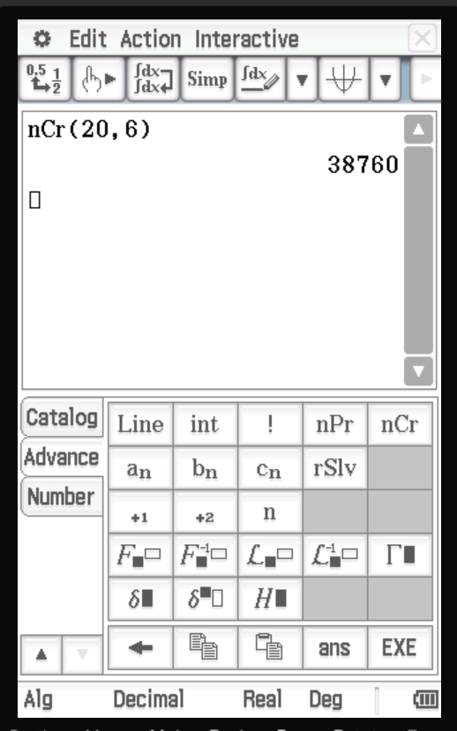

Guided Practice
A team of 6 swimmers is to be selected from a group of 20 swimmers. Find the number of different ways in which the team can be selected.
$n=20, r=6$
${}_{ }^{20}{C_{6}=\left({20 \atop 6}\right)=38760}$

Slide 6





Guided Practice
If four flavours of ice-cream are available, how many double-scoop selections are possible if two different flavours must be used?
$n=4, r=2$
${}_{ }^{4}{C_{2}=\left({4 \atop 2}\right)}$
$=\frac{4!}{\left(4−2\right)!2!}$
$=\frac{4!}{2!2!}$
$=\frac{4×3×2!}{2!2!}$
$=\frac{4×3}{2}$
$=6$

Slide 7



Guided PRactice
3 coats and 2 dresses are to be selected from 9 coats and 7 dresses. Find the number of different selections that can be made.
Selecting Coats: $\left({9 \atop 3}\right)$
Selecting Dresses: $\left({7 \atop 2}\right)$
$$\left({9 \atop 3}\right)×\left({7 \atop 2}\right)=1764$$
Note: when selecting the 3 coats and the 2 dresses from 9 coats and 7 dresses, there are actually two independent event, selecting 3 from 9 and selecting 2 from 7. Therefore, you need to use the multiplication principle to determine the number of selections.

Slide 8



Guided PRactice
A team of 3 boys and 3 girls is to be chosen from a group of 8 boys and 5 girls. How many different teams are possible?
Boys: $\left({8 \atop 3}\right)$
Girls: $\left({5 \atop 3}\right)$
$$\left({8 \atop 3}\right)×\left({5 \atop 2}\right)=560$$

Slide 9









Guided Practice
Nick is making an invitation list for his party and has seven friends to choose from. If he may choose to invite any number of friends (from None to all seven), how many possible party lists does he have?
0 friends
$${}_{ }^{7}{C_{0}}$$
1 friend
$${}_{ }^{7}{C_{1}}$$
2 friends
$${}_{ }^{7}{C_{2}}$$
Sum it up
3 friends
$${}_{ }^{7}{C_{3}}$$
${}_{ }^{7}{C_{0}}+{}_{ }^{7}{C_{1}}+{}_{ }^{7}{C_{2}}++{}_{ }^{7}{C_{3}}+{}_{ }^{7}{C_{4}}+{}_{ }^{7}{C_{5}}$ $+{}_{ }^{7}{C_{6}}$ $+{}_{ }^{7}{C_{7}}$
4 friends
$${}_{ }^{7}{C_{4}}$$
5 friends
$${}_{ }^{7}{C_{5}}$$
$$=128$$
6 friends
$${}_{ }^{7}{C_{6}}$$
7 friends
$${}_{ }^{7}{C_{7}}$$

Slide 10
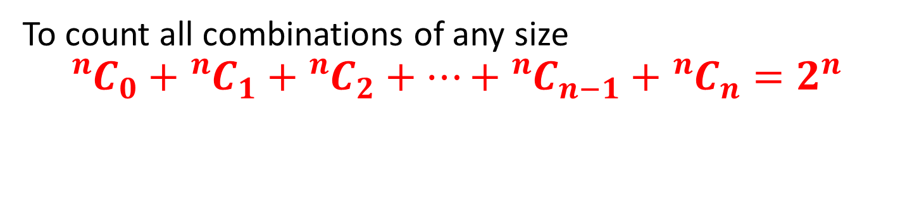
Selection of any size
Concept Development
To count all combinations of any size
$${}_{ }^{n}{C_{0}}+{}_{ }^{n}{C_{1}}+{}_{ }^{n}{C_{2}}+…+{}_{ }^{n}{C_{n−1}}+{}_{ }^{n}{C_{n}}=2^{n}$$

Slide 11

Guided Practice
Nick is making an invitation list for his party and has seven friends to choose from. If he may choose to invite any number of friends (from None to all seven), how many possible party lists does he have?
$$2^{7}=128$$

Slide 12



Guided Practice
Nick is making an invitation list for his party and has seven friends to choose from. If he may choose to invite any number of friends (from one to all seven), how many possible party lists does he have?
0 friends
$${}_{ }^{7}{C_{0}}$$
1 friend
$${}_{ }^{7}{C_{1}}$$
2 friends
$${}_{ }^{7}{C_{2}}$$
Sum it up
3 friends
$${}_{ }^{7}{C_{3}}$$
${}_{ }^{7}{C_{0}}+{}_{ }^{7}{C_{1}}+{}_{ }^{7}{C_{2}}++{}_{ }^{7}{C_{3}}+{}_{ }^{7}{C_{4}}+{}_{ }^{7}{C_{5}}$ $+{}_{ }^{7}{C_{6}}$ $+{}_{ }^{7}{C_{7}}$
4 friends
$${}_{ }^{7}{C_{4}}$$
5 friends
$${}_{ }^{7}{C_{5}}$$
$$=128$$
6 friends
$${}_{ }^{7}{C_{6}}$$
7 friends
$${}_{ }^{7}{C_{7}}$$

Slide 13
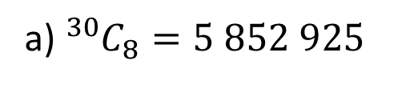



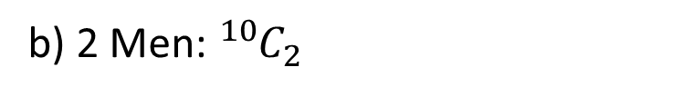
Guided Practice
A survey is to be conducted, and eight people are to be chosen from a group of 30.
How many different ways could the eight be chosen?
If the group contain 10 men and 20 women, how many groups containing exactly two men are possible?
a) ${}_{ }^{30}{C_{8}=5 852 925}$
b) 2 Men: ${}_{ }^{10}{C_{2}}$
How many women must be surveyed?
8-2=6
6 Women: ${}_{ }^{20}{C_{6}}$
$${}_{ }^{10}{C_{2}}×{}_{ }^{20}{C_{6}}$$
$$=1 744 200$$

Slide 14
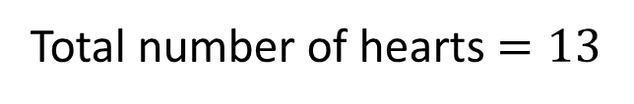





Guided Practice
From a standard 52-card deck, how many 7 card hands have 5 spades and 2 hearts?
Total number of spades $=13$
5 spades: ${}_{ }^{13}{C_{5}}$
Total number of hearts $=13$
2 hearts: ${}_{ }^{13}{C_{2}}$
$${}_{ }^{13}{C_{5}}×{}_{ }^{13}{C_{2}}$$
$$=100 386$$

Slide 15


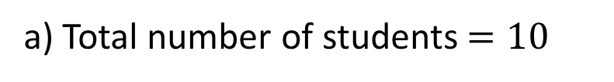



Guided PRactice
A quiz team of 5 students is to be selected from 6 boys and 4 girls. Find the number possible team that can be selected if
there are no restrictions; and
there are more boys than girls.
a) Total number of students $=10$
5 students: ${}_{ }^{10}{C_{5}}=252$
$${}_{ }^{6}{C_{5}}×{}_{ }^{4}{C_{0}}=6$$
b) 5 boys 0 girls:
4 boys 1 girl:
$${}_{ }^{6}{C_{4}}×{}_{ }^{4}{C_{1}}=60$$
3 boys 2 girls:
$${}_{ }^{6}{C_{3}}×{}_{ }^{4}{C_{2}}=120$$
$$6+60+120=186$$
Note: For (b), there are three situations. 5 boys and no girl, 4 boys and 1 girl, 3 boys and 2 girls. In this case, we use the multiplication principle to calculate the respective selections and then use the addition principle to calculate the total selection.

Slide 16
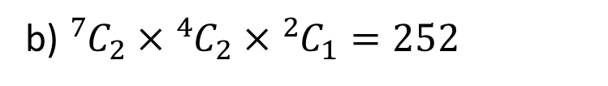
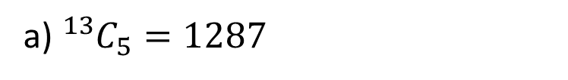
Guided PRactice
Sofia has to play 5 pieces of music for her ATAR music performance. She has 13 pieces to choose from. There are 7 pieces composed by Chopin, 4 composed by Mozart and 2 composed by Bach. Find the number of ways the 5 pieces can be chosen if
there are no restrictions;
there must be 2 pieces by Chopin, 2 pieces by Mozart and 1 piece by Bach;
there must be at least one piece by each composer.
a) ${}_{ }^{13}{C_{5}}=1287$
b) ${}_{ }^{7}{C_{2}}×{}_{ }^{4}{C_{2}}×{}_{ }^{2}{C_{1}}=252$

Slide 17
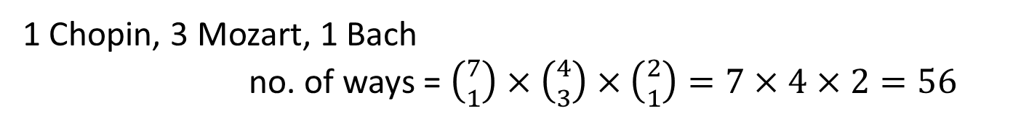
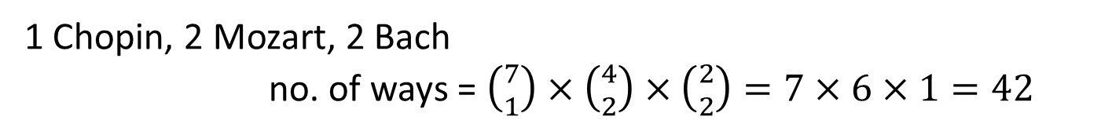
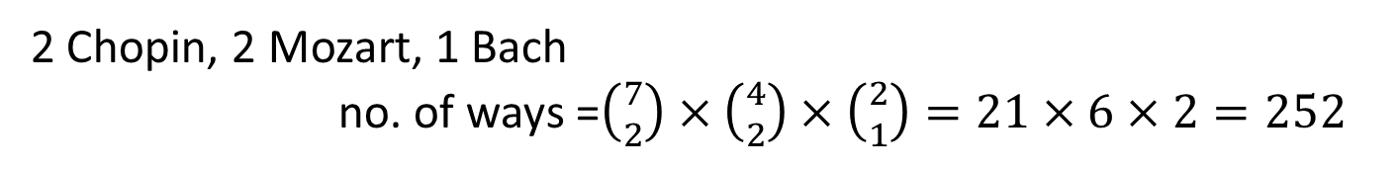
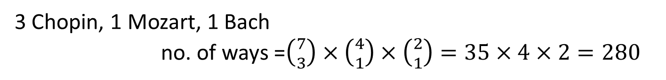
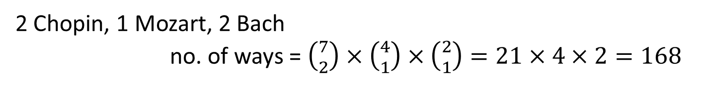
Guided Practice
c) must be at least one piece by each composer.
1 Chopin, 2 Mozart, 2 Bach
no. of ways = $\left({7 \atop 1}\right)×\left({4 \atop 2}\right)×\left({2 \atop 2}\right)=7×6×1=42$
1 Chopin, 3 Mozart, 1 Bach
no. of ways = $\left({7 \atop 1}\right)×\left({4 \atop 3}\right)×\left({2 \atop 1}\right)=7×4×2=56$
2 Chopin, 1 Mozart, 2 Bach
no. of ways = $\left({7 \atop 2}\right)×\left({4 \atop 1}\right)×\left({2 \atop 1}\right)=21×4×2=168$
3 Chopin, 1 Mozart, 1 Bach
no. of ways =$\left({7 \atop 3}\right)×\left({4 \atop 1}\right)×\left({2 \atop 1}\right)=35×4×2=280$
2 Chopin, 2 Mozart, 1 Bach
no. of ways =$\left({7 \atop 2}\right)×\left({4 \atop 2}\right)×\left({2 \atop 1}\right)=21×6×2=252$
Total number of was = 280 + 252 + 168 + 56 + 42 = 798

Slide 18
Independent Practice
Complete Ex 10C

